Slide 1

Numerical Diffusion (Numerical Viscosity)
In upwind scheme for transport equation
$$q_{t}+cq_{x}=0$$
Numerical diffusion arises from a first-order finite difference approximation to $q_{x}$.
Using Taylor series expansion
$$q_{i+1}=q_{i}+q_{x}{\left.​\right|}_{i}∆x+q_{xx}{\left.​\right|}_{i}\frac{{\left(∆x\right)}^{2}}{2}+𝒪{\left(∆x\right)}^{3}$$
$$⇒q_{x}{\left.​\right|}_{i} =\frac{q_{i+1}−q_{i}}{∆x}−q_{xx}{\left.​\right|}_{i}\frac{{\left(∆x\right)}^{2}}{2}−𝒪{\left(∆x\right)}^{3}$$
Original PDE become
$$q_{t}+c\frac{q_{i+1}−q_{i}}{∆x}=c\left(q_{xx}{\left.​\right|}_{i}\frac{{\left(∆x\right)}^{2}}{2}+𝒪{\left(∆x\right)}^{3}\right)$$
$$⇒q_{t}+c\frac{q_{i+1}−q_{i}}{∆x}=Dq_{xx}{\left.​\right|}_{i}$$
Where $D$ is the diffusion coefficient due to numerical diffusion.
High order terms are much smaller than the second derivative term, so they can be ignored.
Therefore, original diffusion-free PDE has been transformed into a convection-diffusion PDE due to truncation error.
Notes:
https://scicomp.stackexchange.com/questions/16130/how-can-i-prove-numerical-diffusion-in-upwind-scheme-for-transport-equation
https://convergecfd.com/resources/numerical-viscosity-convergent-science.pdf

Slide 2
What is conservation ?
The rate of change of the solution is due only to fluxes through the boundaries.
Notes:
Leveque FVM for Hyperbolic Problems 38p

Slide 3
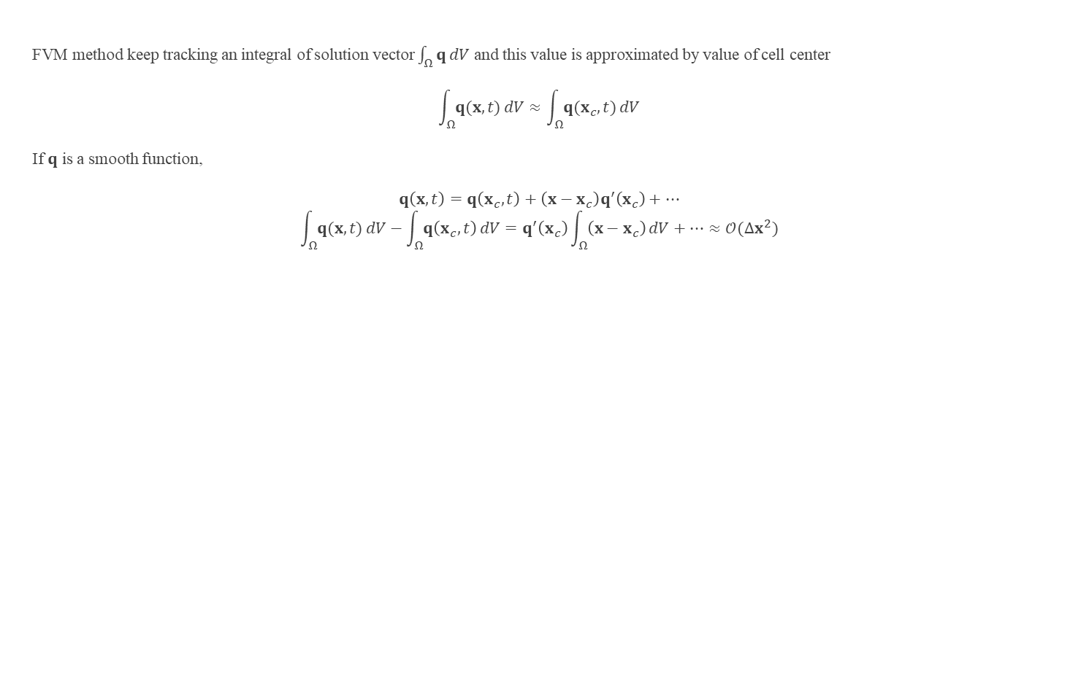
Accuracy of FVM
FVM method keep tracking an integral of solution vector $\int_{Ω}{q}dV$ and this value is approximated by value of cell center
$$\int_{Ω}{q(x,t)}dV≈\int_{Ω}{q(x_{c},t)}dV$$
If $q$ is a smooth function,
$$q\left(x,t\right)=q\left(x_{c},t\right)+\left(x−x_{c}\right)q^{′}\left(x_{c}\right)+…$$
$$\int_{Ω}{q(x,t)}dV−\int_{Ω}{q\left(x_{c},t\right)}dV=q^{′}\left(x_{c}\right)\int_{Ω}{\left(x−x_{c}\right)}dV+…≈𝒪(∆x^{2})$$
Notes:
Leveque FVM for Hyperbolic Problems 86p

Slide 4
If we want to solve Conservation Law as a differential equation approximately.
We should approximate flux to get derivative value of flux.
When we approximate flux at each cell, discontinuity may be occurred at the cell interfaces by our not exact approximation or physically.
If there are discontinuity, we have to calculate flux value exactly(Godunov flux) or approximately(other flux scheme) by considering information about neighbors for solving conservation law properly.

Slide 5
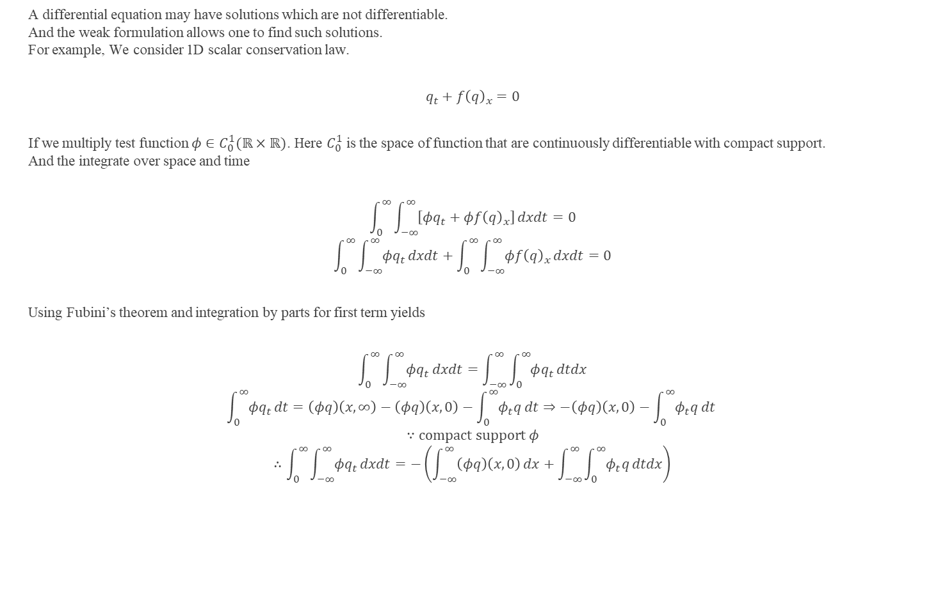
Weak Solution
A differential equation may have solutions which are not differentiable.
And the weak formulation allows one to find such solutions.
For example, We consider 1D scalar conservation law.
$$q_{t}+f{\left(q\right)}_{x}=0$$
If we multiply test function $φ∈C_{0}^{1}(ℝ×ℝ)$. Here $C_{0}^{1}$ is the space of function that are continuously differentiable with compact support.
And the integrate over space and time
$$\int_{0}^{∞}{\int_{−∞}^{∞}{\left[φq_{t}+φf{\left(q\right)}_{x}\right]}}dxdt=0$$
$$\int_{0}^{∞}{\int_{−∞}^{∞}{φq_{t}}}dxdt+\int_{0}^{∞}{\int_{−∞}^{∞}{φf{\left(q\right)}_{x}}}dxdt=0$$
Using Fubini’s theorem and integration by parts for first term yields
$$\int_{0}^{∞}{\int_{−∞}^{∞}{φq_{t}}}dxdt=\int_{−∞}^{∞}{\int_{0}^{∞}{φq_{t}}}dtdx$$
$$\int_{0}^{∞}{φq_{t}}dt=\left(φq\right)\left(x,∞\right)−\left(φq\right)\left(x,0\right)−\int_{0}^{∞}{φ_{t}q}dt⇒−\left(φq\right)\left(x,0\right)−\int_{0}^{∞}{φ_{t}q}dt$$
$$∵compact support φ$$
$$∴\int_{0}^{∞}{\int_{−∞}^{∞}{φq_{t}}}dxdt=−\left(\int_{−∞}^{∞}{\left(φq\right)\left(x,0\right)}dx+\int_{−∞}^{∞}{\int_{0}^{∞}{φ_{t}q}}dtdx\right)$$

Slide 6
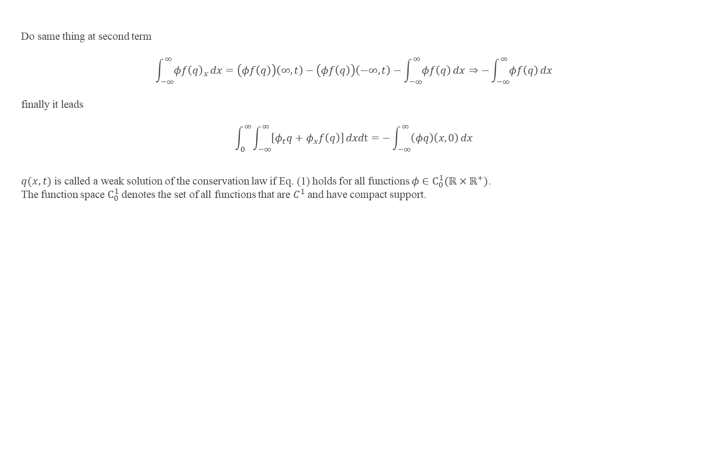
Weak Solution
Do same thing at second term
$$\int_{−∞}^{∞}{φf{\left(q\right)}_{x}}dx=\left(φf\left(q\right)\right)\left(∞,t\right)−\left(φf\left(q\right)\right)\left(−∞,t\right)−\int_{−∞}^{∞}{φf\left(q\right)}dx⇒−\int_{−∞}^{∞}{φf\left(q\right)}dx$$
finally it leads
$$\int_{0}^{∞}{\int_{−∞}^{∞}{\left[φ_{t}q+φ_{x}f\left(q\right)\right]}}dxdt=−\int_{−∞}^{∞}{\left(φq\right)\left(x,0\right)}dx$$
$q(x,t)$ is called a weak solution of the conservation law if Eq. (1) holds for all functions $φ∈C_{0}^{1}(ℝ×ℝ^{+})$.
The function space $C_{0}^{1}$ denotes the set of all functions that are $C^{1}$ and have compact support.
(1)

Slide 7

Compact Support
We consider test function $φ∈C_{0}^{1}(ℝ×ℝ)$. Here $C_{0}^{1}$ is the space of function that are continuously differentiable with compact support.
It means $φ(x,t)$ is identically zero outside of some bounded set, and so the support of the function lies in a compact set.
Here we use phrase identically zero ,to avoid confusion, which means $φ$ is zero functions not $φ=0$.

Slide 8
Well-posed problem
Well-posed problem is the Mathematical models of physical phenomena having following properties
A solution exists
The solution is unique
The solution’s behavior changes continuously with the initial conditions.
State 3 means small perturbation of initial condition lead small change of solution.
Continuum models must often be discretized in order to obtain a numerical solution.
While solutions may be continuous with respect to the initial conditions, they may suffer from numerical instability when solved with finite precision, or with errors in the data.
Even if a problem is well-posed, it may still be ill-conditioned, meaning that a small error in the initial data can result in much larger errors in the answers.
Problems in nonlinear complex system (so called chaotic systems) provide well-known examples of instability.
An ill-conditioned problem is indicated by a large condition number.

Slide 9
Condition number
In the field of numerical analysis, the condition number of a function measures how much the output value of the function can change for a small change in the input argument.
This is used to measure how sensitive a function is to changes or errors in the input, and how much error in the output results from an error in the input.

Slide 10
Stiff equation
https://en.wikipedia.org/wiki/Stiff_equation

Slide 11
Quadratic convergence
https://en.wikipedia.org/wiki/Rate_of_convergence
http://sepwww.stanford.edu/public/docs/sep97/paul1/paper_html/node5.html

Slide 12
Iterative Method
Euler Method : https://en.wikipedia.org/wiki/Euler_method
Newton Method : https://en.wikipedia.org/wiki/Newton%27s_method

